Slide 1
Multiple Granularity

Slide 2
Let's start by understanding the meaning of granularity.
Granularity: It is the size of data item allowed to lock.
Multiple Granularity:
It can be defined as hierarchically breaking up the database into blocks which can be locked.
The Multiple Granularity protocol enhances concurrency and reduces lock overhead.
It maintains the track of what to lock and how to lock.
It makes easy to decide either to lock a data item or to unlock a data item. This type of hierarchy can be graphically represented as a tree.

Slide 3
For example: Consider a tree which has four levels of nodes.
The first level or higher level shows the entire database.
The second level represents a node of type area. The higher level database consists of exactly these areas.
The area consists of children nodes which are known as files. No file can be present in more than one area.
Finally, each file contains child nodes known as records. The file has exactly those records that are its child nodes. No records represent in more than one file.

Slide 4
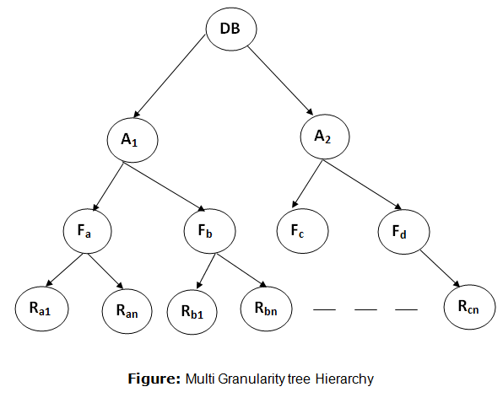
Hence, the levels of the tree starting from the top level are as follows:
Database
Area
File
Record
In this example, the highest level shows the entire database. The levels below are file, record, and fields.

Slide 5
There are three additional lock modes with multiple granularity:
Intention Mode Lock
Intention-shared (IS): It contains explicit locking at a lower level of the tree but only with shared locks.
Intention-Exclusive (IX): It contains explicit locking at a lower level with exclusive or shared locks.
Shared & Intention-Exclusive (SIX): In this lock, the node is locked in shared mode, and some node is locked in exclusive mode by the same transaction.
Compatibility Matrix with Intention Lock Modes: The below table describes the compatibility matrix for these lock modes:

Slide 6
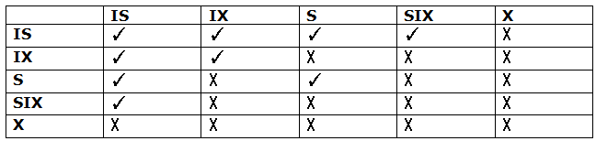

Slide 7
It uses the intention lock modes to ensure serializability. It requires that if a transaction attempts to lock a node, then that node must follow these protocols:
Transaction T1 should follow the lock-compatibility matrix.
Transaction T1 firstly locks the root of the tree. It can lock it in any mode.
If T1 currently has the parent of the node locked in either IX or IS mode, then the transaction T1 will lock a node in S or IS mode only.
If T1 currently has the parent of the node locked in either IX or SIX modes, then the transaction T1 will lock a node in X, SIX, or IX mode only.
If T1 has not previously unlocked any node only, then the Transaction T1 can lock a node.
If T1 currently has none of the children of the node-locked only, then Transaction T1 will unlock a node.

Slide 8
Observe that in multiple-granularity, the locks are acquired in top-down order, and locks must be released in bottom-up order.
If transaction T1 reads record R_{a9} in file F_{a}, then transaction T1 needs to lock the database, area A₁ and file F_{a} in IX mode. Finally, it needs to lock R_{a2} in S mode.
If transaction T2 modifies record R_{a9} in file F_{a}, then it can do so after locking the database, area A₁ and file F_{a} in IX mode. Finally, it needs to lock the R_{a9} in X mode.
If transaction T3 reads all the records in file F_{a}, then transaction T3 needs to lock the database, and area A in IS mode. At last, it needs to lock F_{a} in S mode.
If transaction T4 reads the entire database, then T4 needs to lock the database in S mode.

Slide 9
Multi-version Schemes
Multi-version protocol minimizes the delay for reading operation and maintains different versions of data items.
For each writes operation performed, it creates a new version of transaction data so that whenever any transaction performs read operation to read that data then the appropriate created data version is selected by the control manager to make that read operation conflict-free and successful.
When the write operation and new version of data is created then that new version contains some information that is given below

Slide 10
Content: This field contains the data value of that version.
Write_timestamp: This field contains the timestamp of the transaction whose new version is created.
Read_timestamp: This field contains the timestamp of the transaction of that transaction that will read that newly created value.
Now let us understand this concept using an example. Let T1 and T2 be two transactions having timestamp values 15 and 10, respectively.

Slide 11

The transaction T2 calls for a write operation on data (let’s say X) from the database.
As T2 calls write operation, then a new version of data value X is created, which contains the value of X, timestamp of T2, and timestamp of that transaction which will read X, but in this case, no one is reading the newly created value so that filed remains empty.

Slide 12
Now let the transaction T1 (having timestamp 15) call a read operation to read the newly created value X, then the newly created variable contained will be
If timestamp of T2 is less than or equal to timestamp of T1 then
Read(X) operation performed by T1: In this case, content of X is returned to T1.
Write(X) operation performed by T1: In this case, T1 will be rolled back if timestamp of T1 is smaller than timestamp of read operation on X. And if timestamp of T1 is equal to the timestamp of write operation on X then the new version is created again with new contents.

